Slide 1
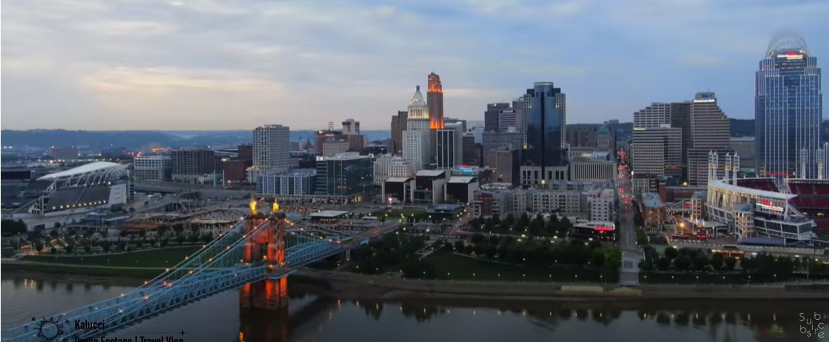
Cincinnati’s Riverfront Renaissance

Slide 2
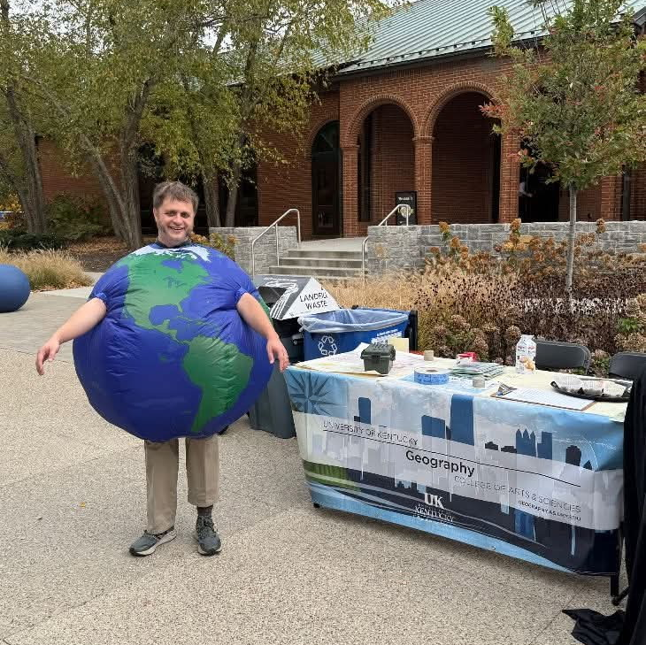
Charles Altendorf
UK Geography BA 2007 - fall 2012
New Maps Plus 2022 – spring 2025
KAMP President (2023-2025)
Senior GIS Specialist (KY) at American Water (5 Years)
12 Years GIS experience:
Regional Government, Oil, Fiber, and Water.

Slide 3
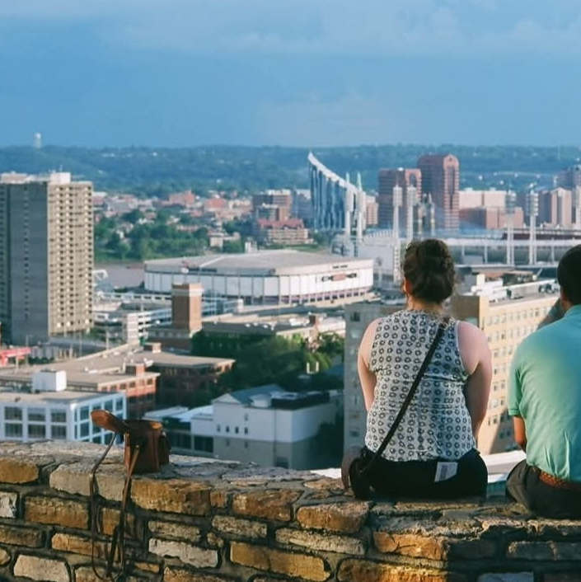
Personal Inspiration
Friends from family membership in the Germain Society of Cincinnati
Friends from Boone County High School
Urban Geography classes in Undergrad at UK
Mutiple visits per year to downtown Cincinnati

Slide 4
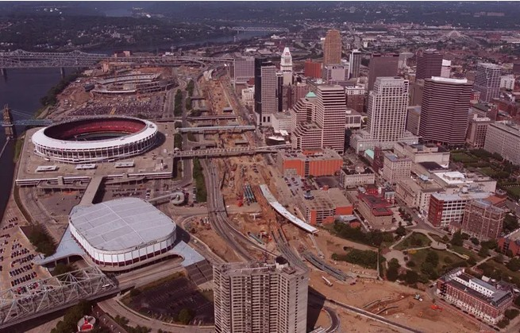
Project Background
1

Slide 5
“My biggest memory of that time was actually watching Monday Night Football and the Bengals were on it, probably in like 2003. And you know, to this day on Monday Night Football on the broadcast, they do like kind of shots from around the city of just different street corners or what have you, to see what sort of night life is going on. And I remember the announcers making a joke because there was no one on the streets.” Bill Schult Interview

Slide 6
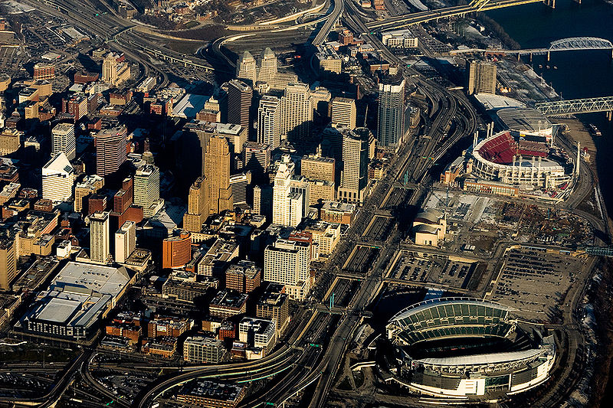
Statistical Inspiration
In 2010, Cincinnati’s population had fallen to 296,943 from a peak of 503,998 in 1950.
In 2020, that trend reversed with Cincinnati growing to 309, 317
Census Tract 265 was a main driver, gaining 1,037 people

Slide 7
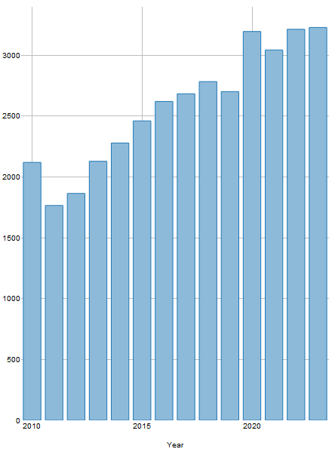
Census Tract 265 Population 2010-2023 (Non Census Years Are Estimated)

Slide 8
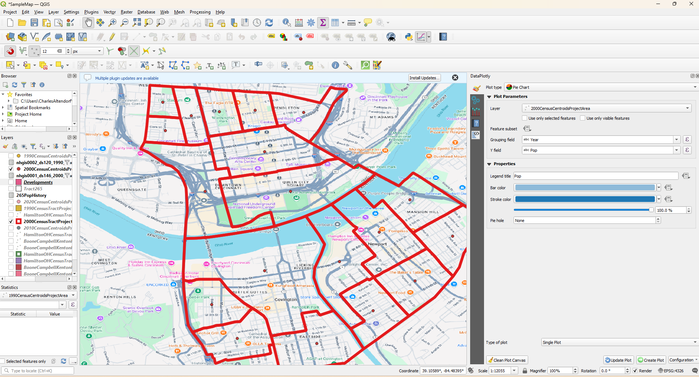
Determining Analysis Area
2

Slide 9
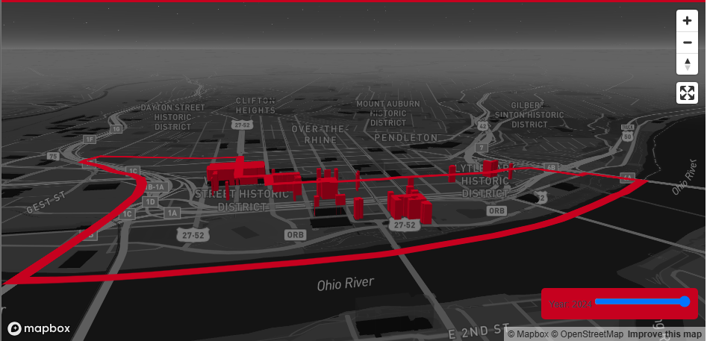
Trial and Error
Initial Focus was on just Census Tract 265 from 2010-2020.
Boundaries didn’t change, it had clear measurable growth.
It’s still the landing page for the main map however ancillary data provides great context.

Slide 10
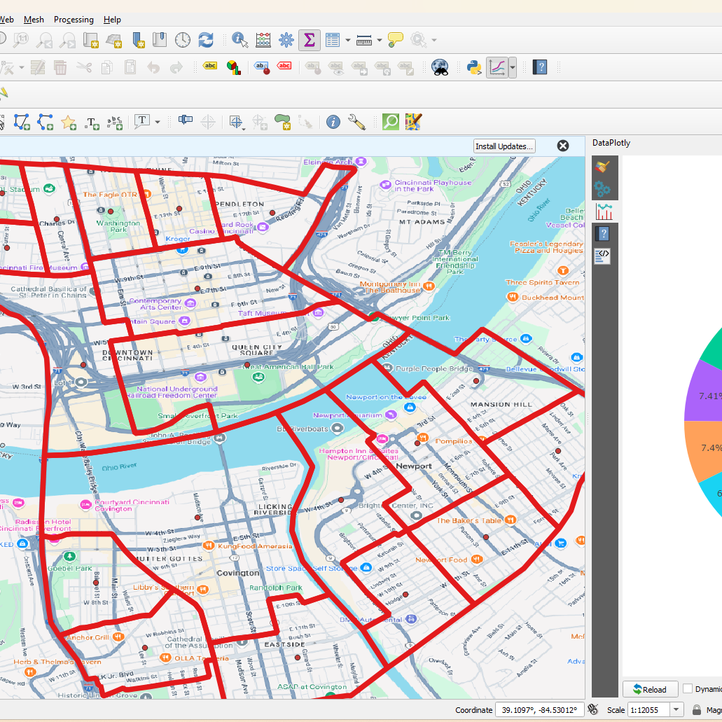
Expanded Area
Expanded project area for more statistical analysis includes:
Tracts from Kentucky and Ohio side of the river for comparison
Data from 1990 to 2020
Pie charts were generated using an interesting QGIS plugin called Data Plotly

Slide 11
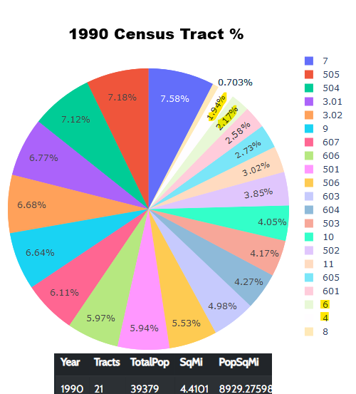
1990 Census Tract Data (tracts 4 and 6 become 265 later)

Slide 12
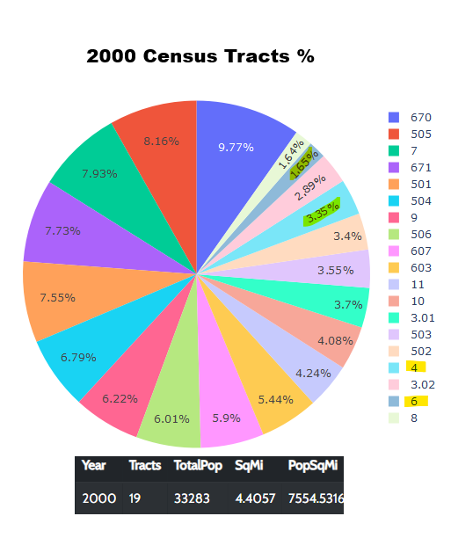
2000 Census Tract Data (tracts 4 and 6 become 265 later)

Slide 13
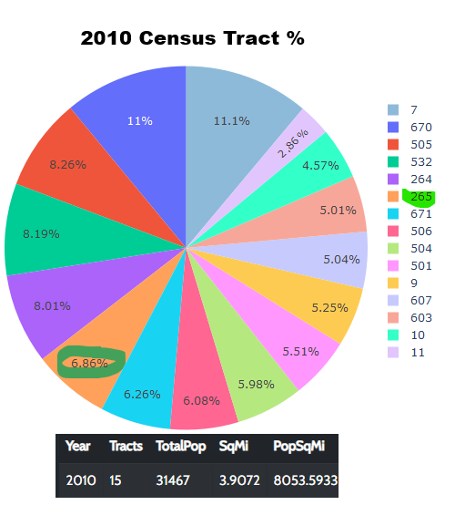
2010 Census Tract Data

Slide 14
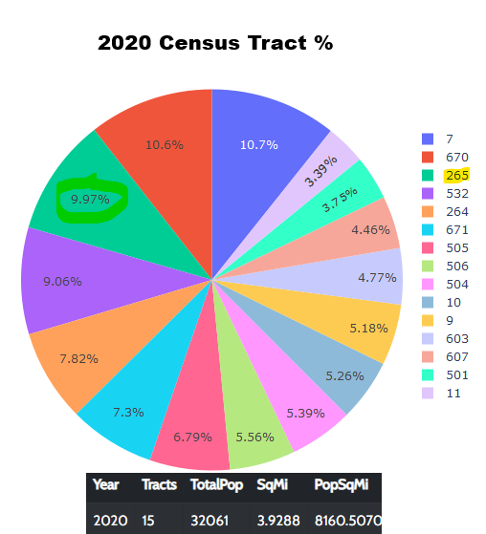
2020 Census Tract Data

Slide 15
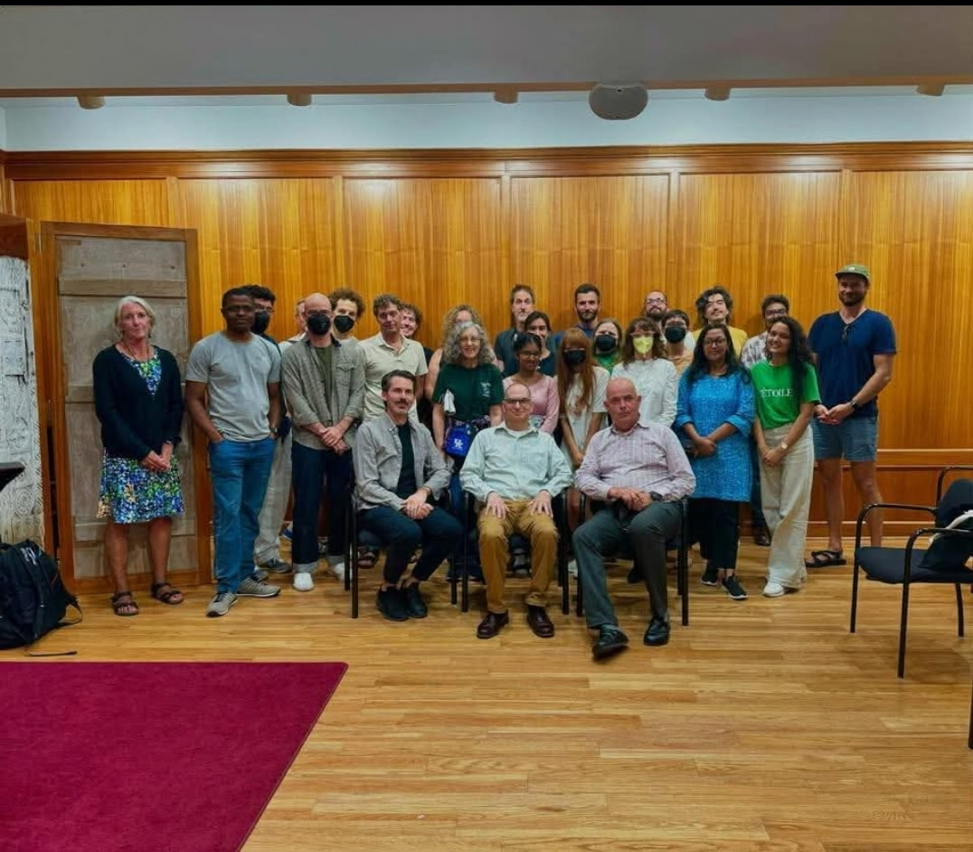
Scholarly Context
3

Slide 16
Types
Professional Articles
Similar Projects
Technologies
Scholarly articles about urban riverfront revitalizations around the world.
Similar interactive maps.
Various technologies were explored and used to build the final product.
1
2
3

Slide 17
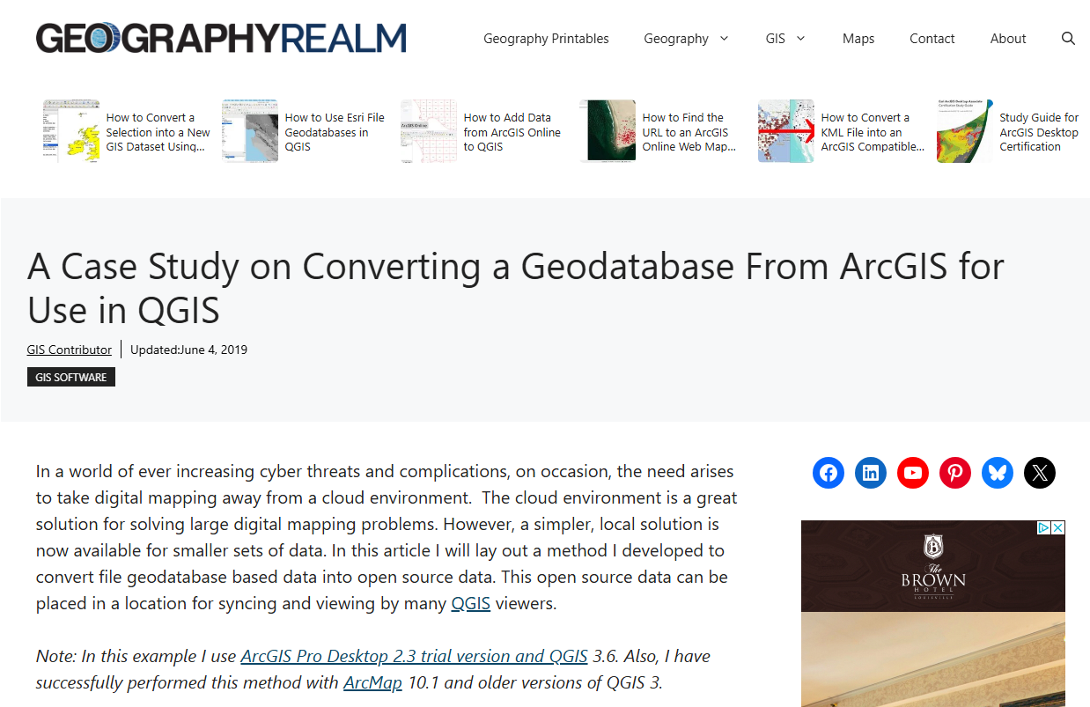
Professional Articles

Slide 18
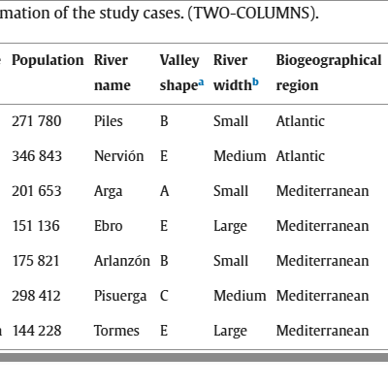
Duran, et al
Examined how urban activities interact with the waterfront
A model was created to analyze the space around the riverbank
Hard scapes may limit public interaction with the water. More transition zone may benefit the public and nature.
Found this particularly interesting because these cities were a similar size to Cincinnati

Slide 19
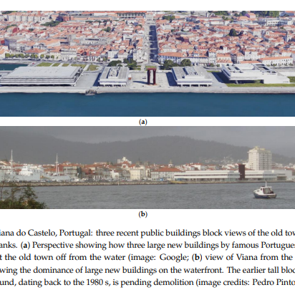
Pinto, et al
Analyzed Projects in Tbilisi, Ipswich, London, Ponte de Sor, and Houston
Identified 5 main pitfalls of riverfront development:
poor location
inadequate budget
mismatched programming
bad timing
inappropriate design choices

Slide 20
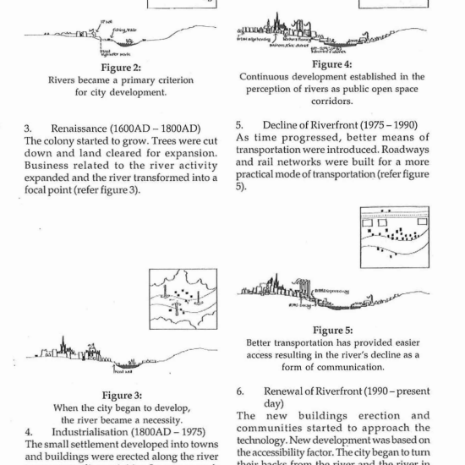
Hussein
Analyzed urban riverfronts like Singapore, Sarawak, Boston, and London.
Studied historical development of urban riverfronts from ancient to modern times.
The central theme is the riverfront becoming the driver of urban development

Slide 21
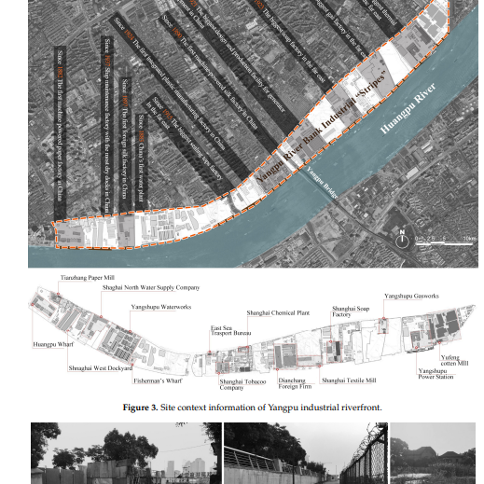
Wu, et al
Similar to Hussein’s article with a more narrow scope.
Analyzed Shanghai river development and interaction from the 1300s to present.

Slide 22
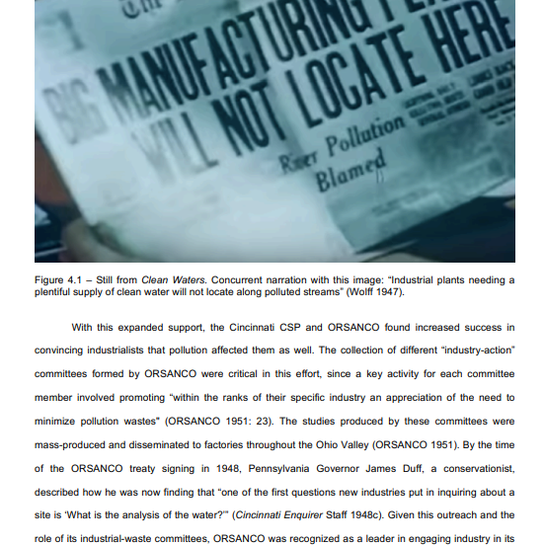
Pettit
Examines the development of Cincinnati’s Riverfront from 1985 to when it was written in 2019.
Adds lots of context to my work.
Only has limited static images in 255 pages.
Doesn’t fully include the impact of the development boom of the last ten years because it’s a bit older.

Slide 23
Similar Projects
our office
Find more maps at slidescarnival.com/extra-free-resources-icons-and-maps

Slide 24
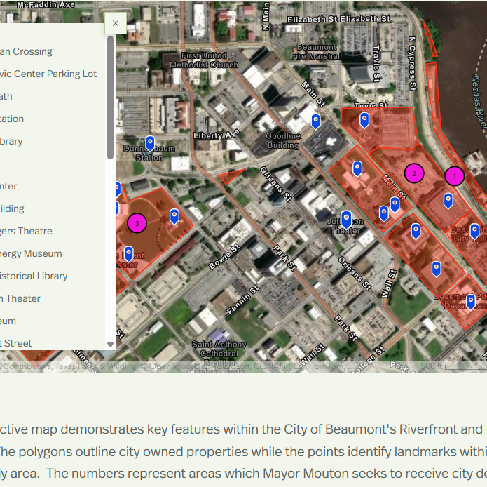
City of Beaumont
Study on reviving historic project to connect riverfont to lake district.
Easy to use with ArcGIS online formatting.
Seems to omit private sector’s role in redevelopment.

Slide 25
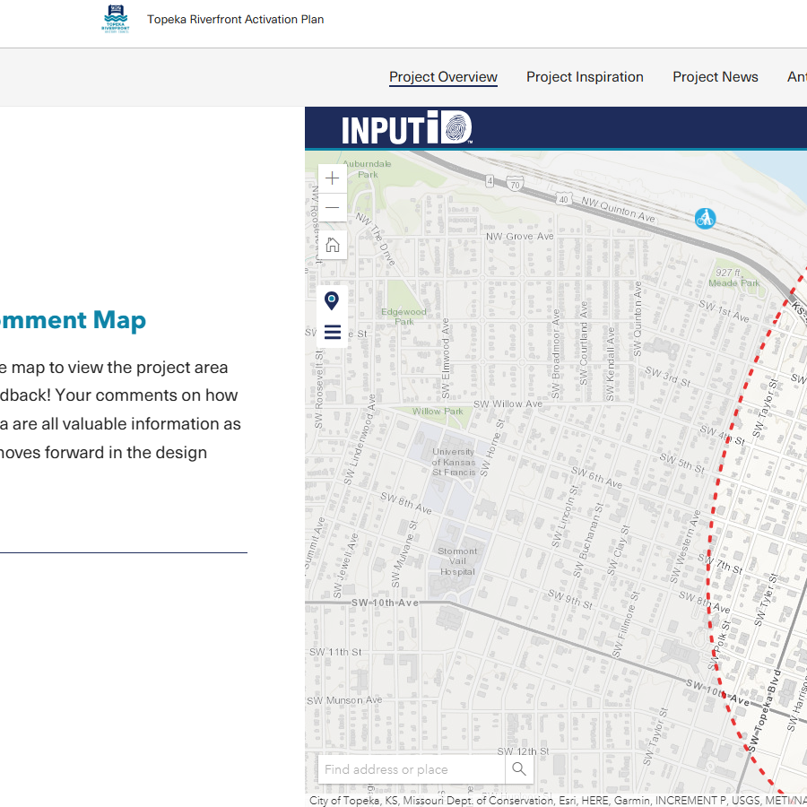
Topeka Riverfront Activation Plan
Study on efforts to revitalize Topeka’s Riverfront.
Easy to use with ArcGIS online story map formatting.
Cites Cincinnati as one of it’s inspirations
Boxy formatting seemed like it could’ve benefitted from some of the customization that I used with
Open source.

Slide 26
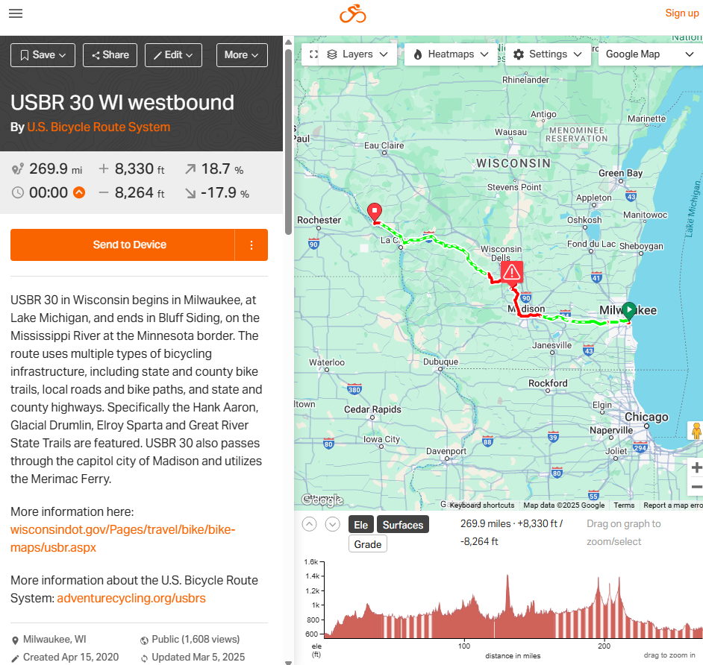
Ride with GPS
Interactive Cyclist Route Map
Extremely intuitive
Loaded with easily accessed external information.
Does not have a 3d Component.

Slide 27
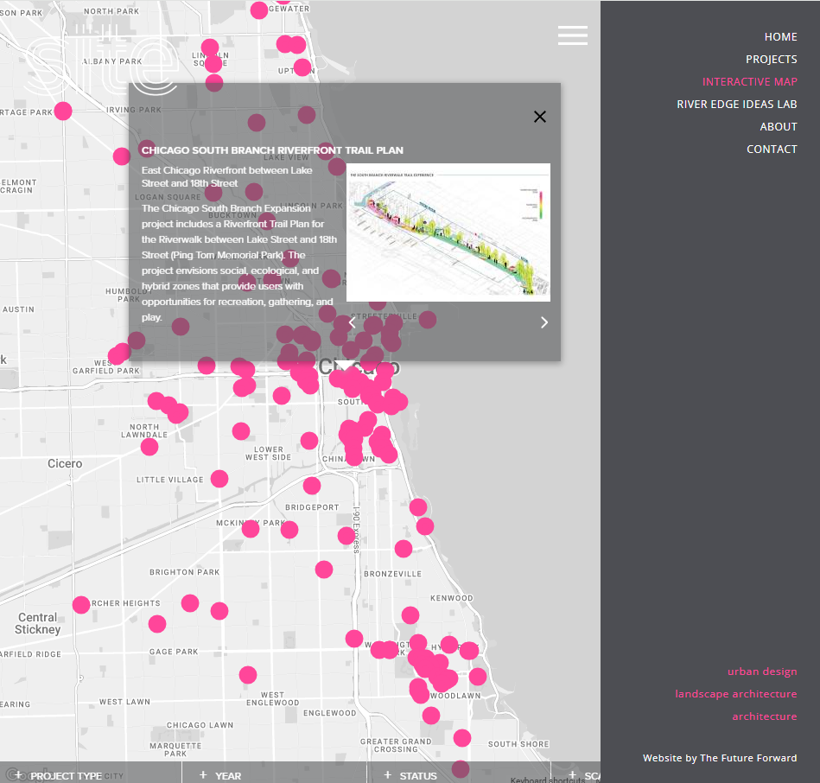
Site Design
Map of Chicago Architecture firms projects
Extremely intuitive
Loaded with easily accessed external information.
Very visually pleasing
Does not have a 3d Component.
Closest inspiration for my project

Slide 28
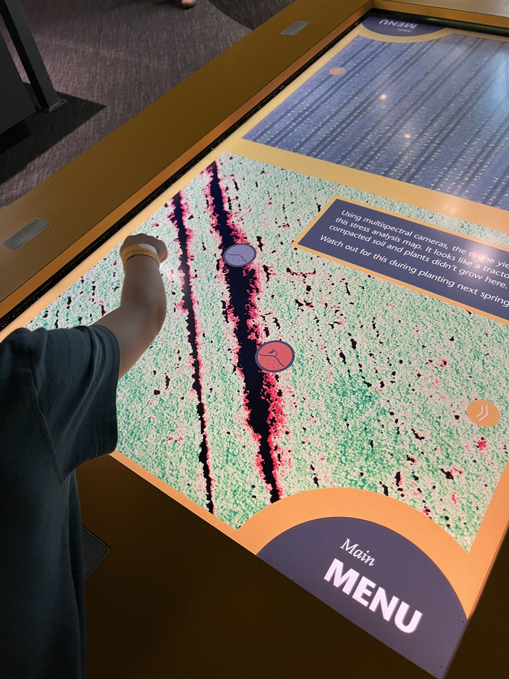
Technologies

Slide 29
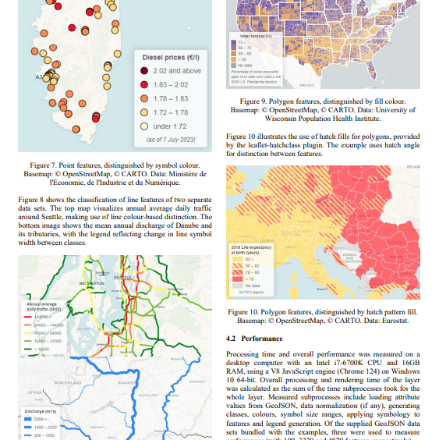
Balla, et all
Attribute Leaflet’s popularity to ease of ease of use, lightweight nature, high customizability, and mobile-friendly design, all of which reduce the need for extensive programming experience
identify three key limitations of Leaflet: it does not natively support data classification, hatching fills, or automatic legend generation. To address these shortcomings, they introduce a custom plugin

Slide 30
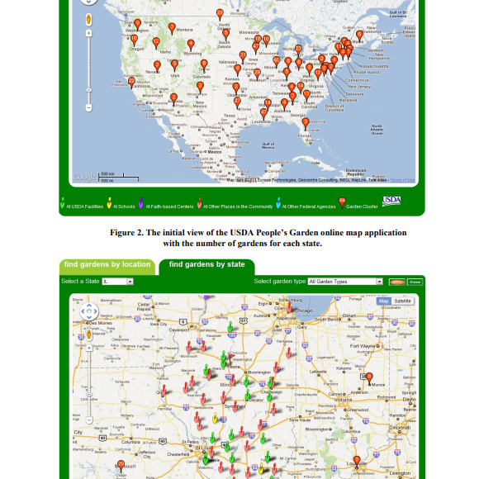
Hu, et all
Overview of the evolution of google maps api.
Provide screenshots on the tools effectiveness and functionality in creating a public mapping tool.
I think suspect many elements of it were used to build the site-design map.
I found the learning curve too steep for my project.

Slide 31
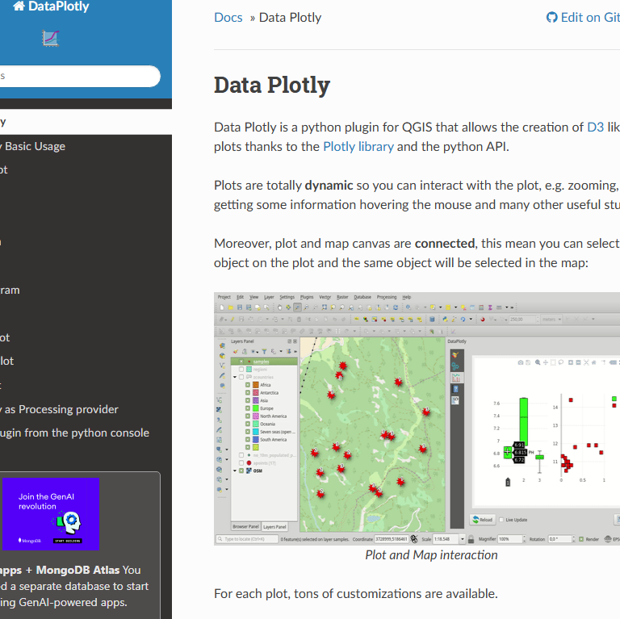
DataPlotly
Great plugin for QGIS.
Allowed me to generate supporting graphs for my concepts rapidly

Slide 32
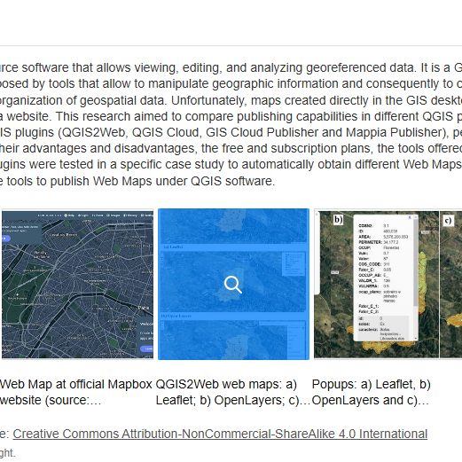
Duarte, et all
Compares and contrasts 4 plugins to publish web maps from QGIS:
QGIS2Web
QGIS Cloud
GIS Cloud Publisher
Mappia
Examined these for a bit and once again found the learning curve a bit steep for the limited timeframe

Slide 33
Eriksson, et al
explains the process of creating stylesheets within Mapbox and deploying them for use in web browsers.
while the tool is useful, it struggles with performance under heavy use, particularly with high GPU demands
I decided that the ease of creating the 3d building effect outweighed any minor slowdowns experienced with Mapbox

Slide 34
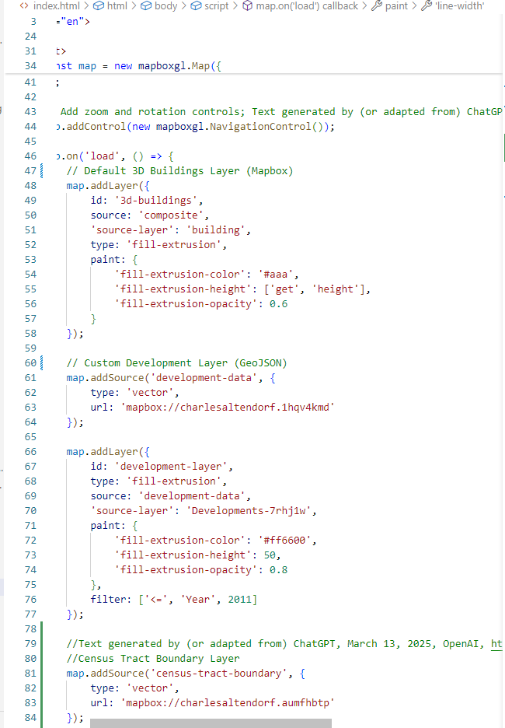
Page Methodology
4

Slide 35
Methodology Highlights
After working with a few prototypes, key elements emerged for the map.
Mapbox was chosen over leaflet to add a 3D component
Bulma was chosen over bootstrap to make it flow more seamlessly between mobile and desktop with less coding.
Splash screen was added for deeper dramatic effect
Timeline was added to main page so users didn’t have to go to readme to view it.
Quotes were taken from interviews and sprinkled in to add a humanizing element.

Slide 36
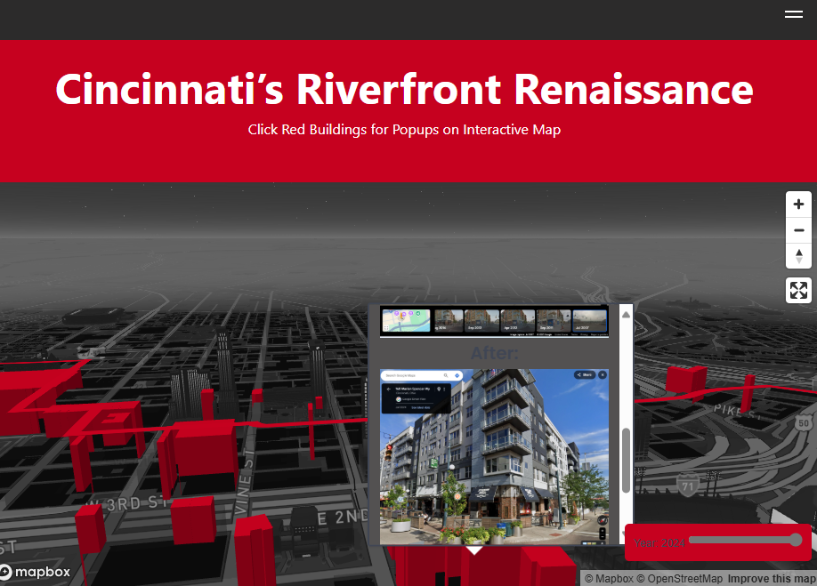
Page Main Componets
Page
Mapbox
Other Elements
Splash Screen
Developments layer with Popups
Slider
Sidebar with readme and interview links
Larger Timeline with Pictures, Commentary, and quotes
Hook

Slide 37
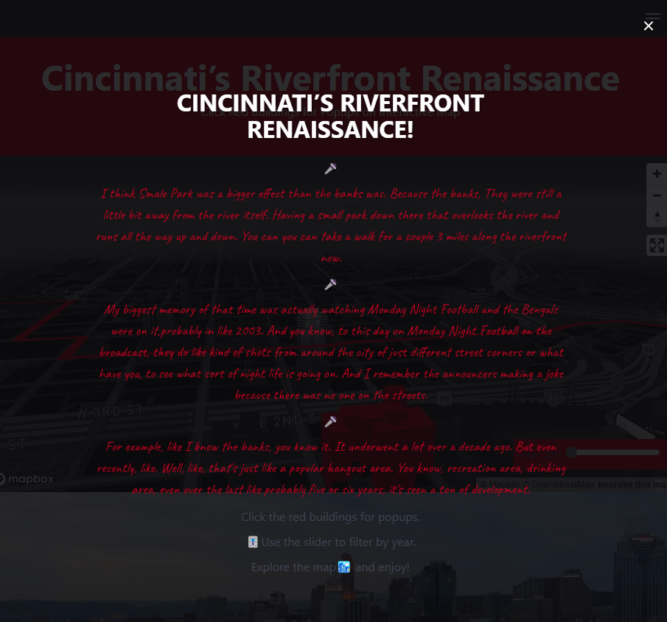
Splash Screen

Slide 38
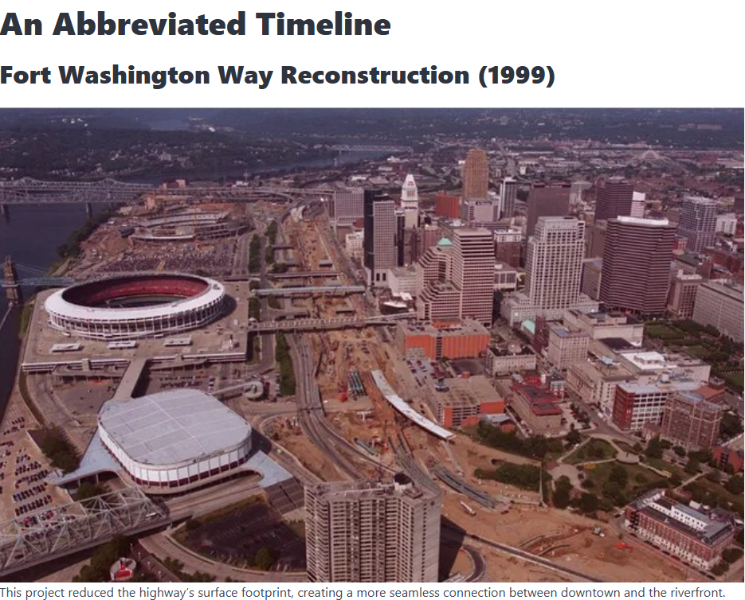
Mapbox with Popups

Slide 39

Developments Layer Generation
Obtain CAGIS Building Footprints Layer
Identify establishments and residences that changed or were built from 2010 to present from Downtown Cincy website
Use QGIS to generate a geojson that has the indentified buildings with fields to use for filtering like years and type
Add in the before and after streetviews from google earth to appear for context in the popups.

Slide 40
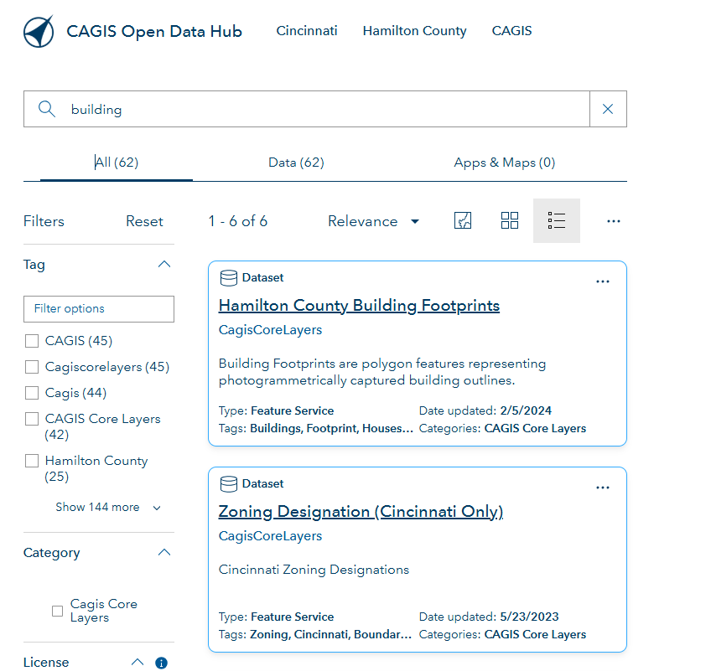
CAGIS Building Footprints

Slide 41
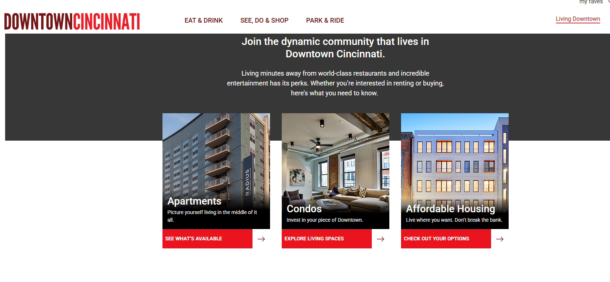
Downtown Cincinnati Website

Slide 42
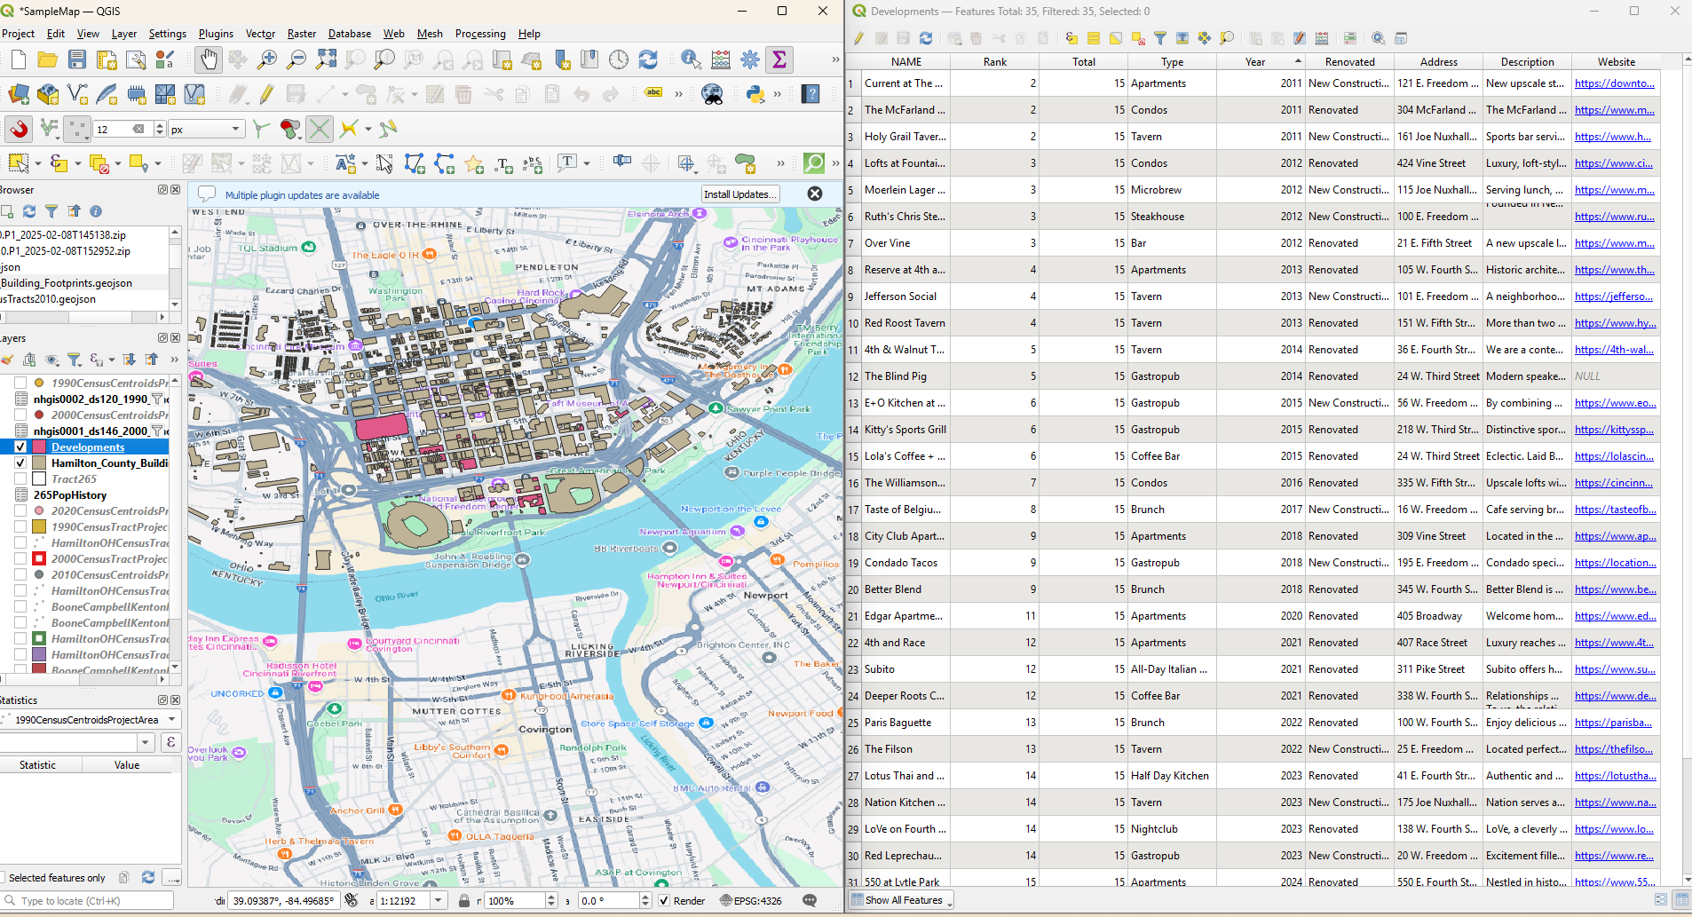
Creating useful Geojson

Slide 43
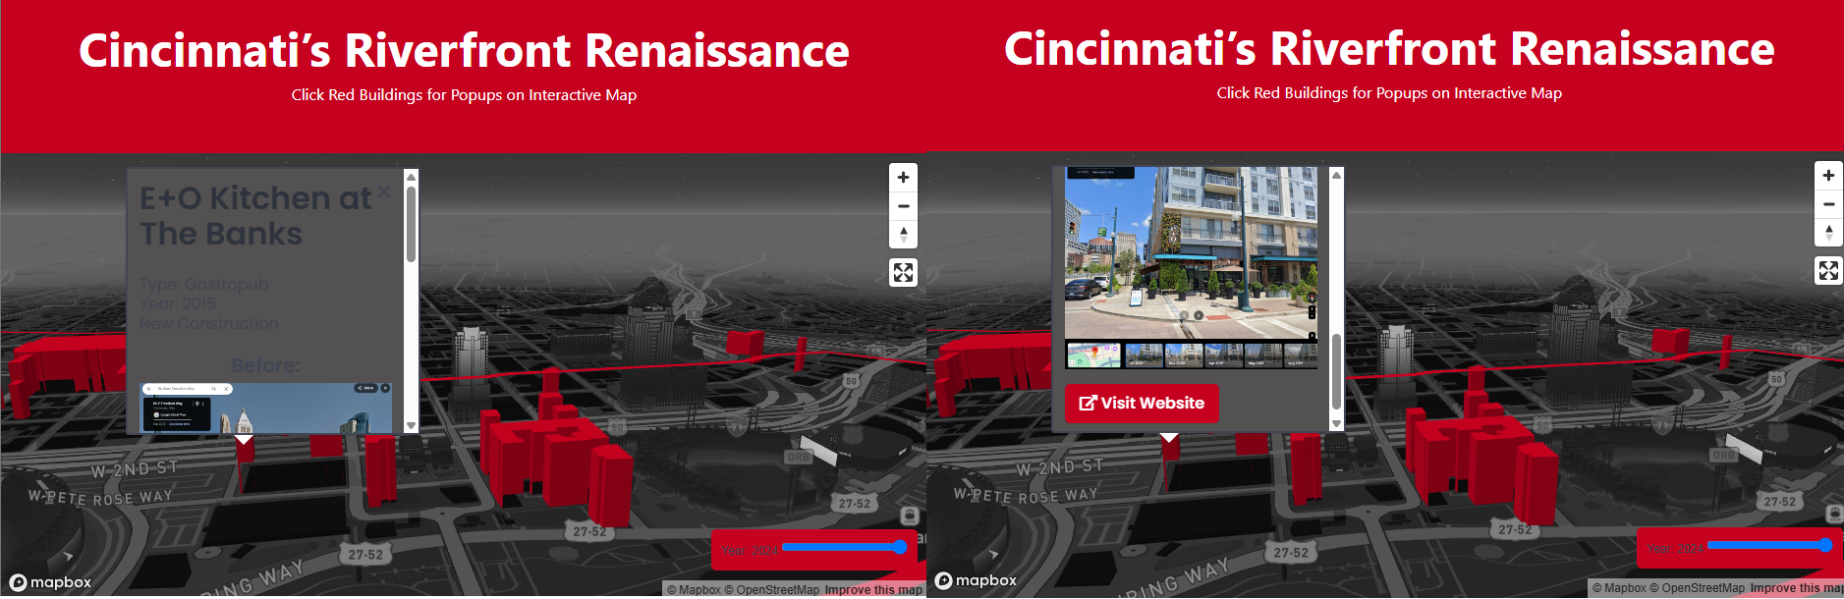
Mapbox with Popups

Slide 44
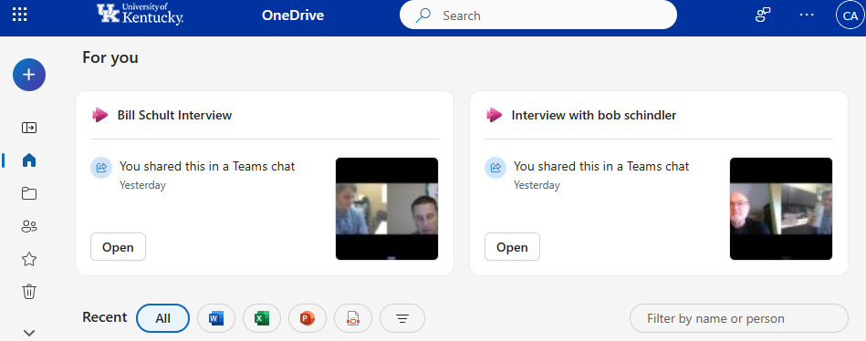
Interviews Methodology
5

Slide 45
Interview Generation
Conduct interviews using University teams account
Download mp4s from University OneDrive and convert them to mp3s in Audacity
Upload interviews to Podbean and create links for website
Download Transcript from University OneDrive and pull quotes from it for page.

Slide 46
Conducting interviews

Slide 47
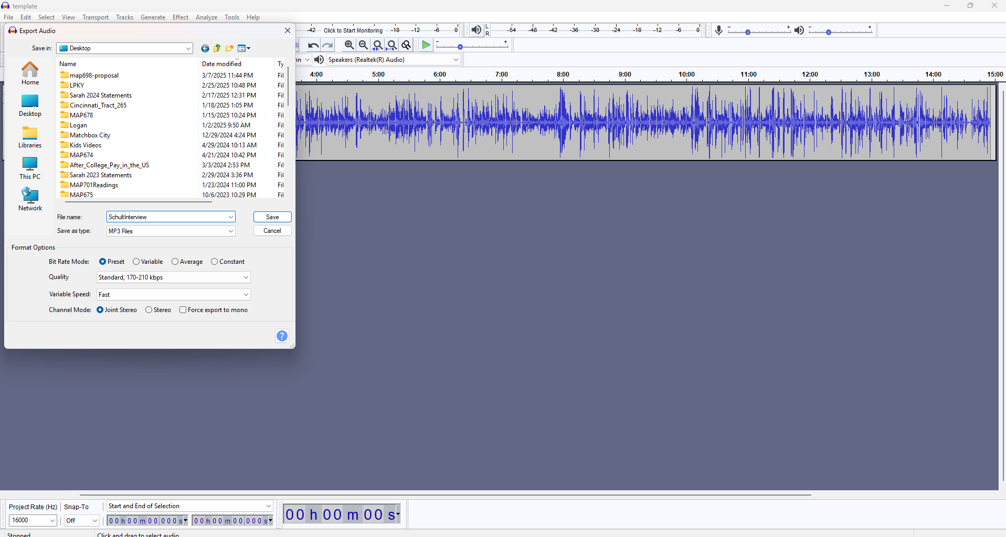
Audacity Conversion

Slide 48
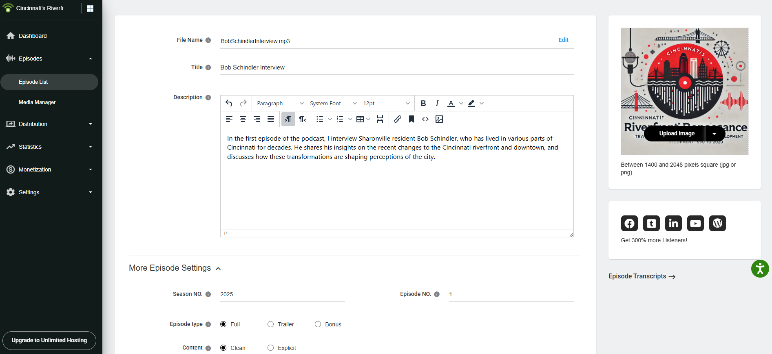
Podbean Upload

Slide 49
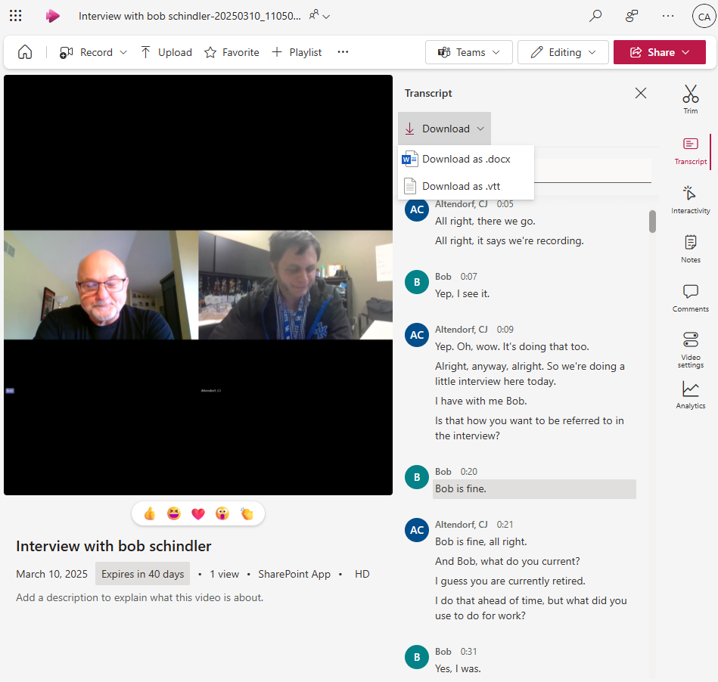
Transcript Extraction

Slide 50
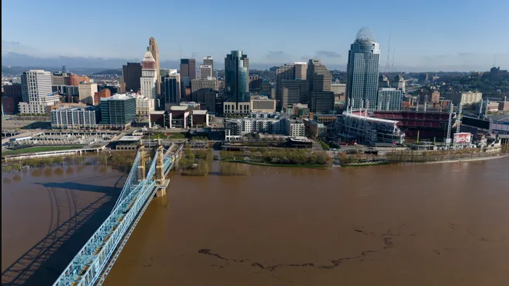
Renaissance under Threat?
6

Slide 51
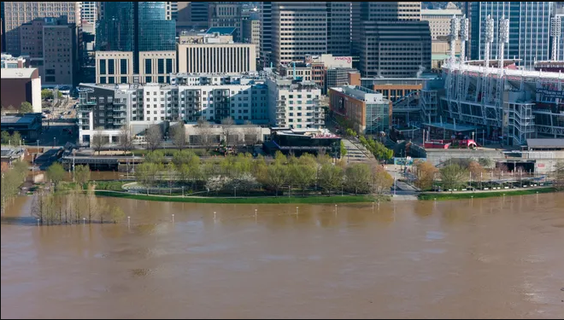
“I think Smale Park was a bigger effect than the banks was. Because the banks, They were still a little bit away from the river itself. Having a small park down there that overlooks the river and runs all the way up and down. You can you can take a walk for a couple 3 miles along the riverfront now.” Bob Schindler Interview

Slide 52
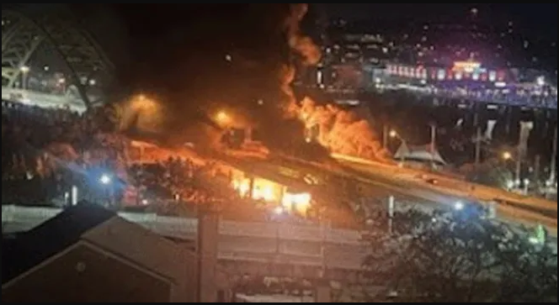
I-471 Bridge Fire (Playground Arson)

Slide 53
April 7 Historic Flooding

Slide 54
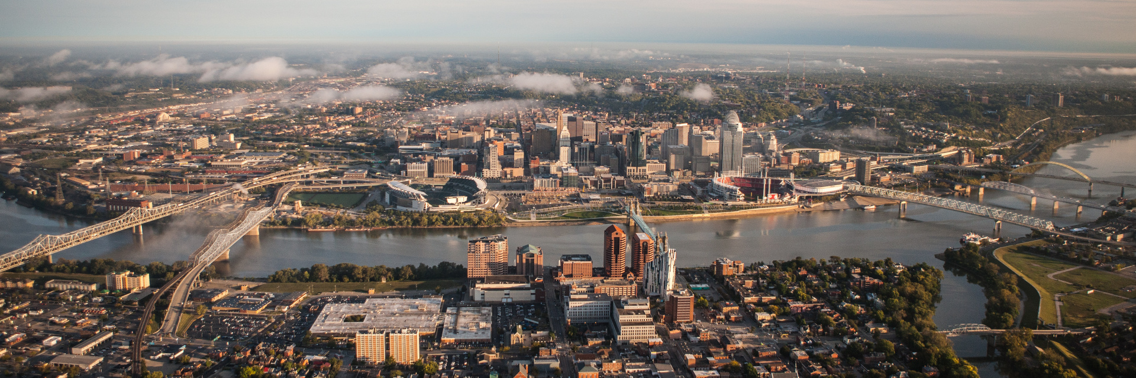
“For example, like I know the banks, you know it. It underwent a lot over a decade ago. But even recently, like. Well, like, that's just like a popular hangout area. You know, recreation area, drinking area, even over the last like probably five or six years, it's seen a ton of development.” Bob Schindler Interview

Slide 55
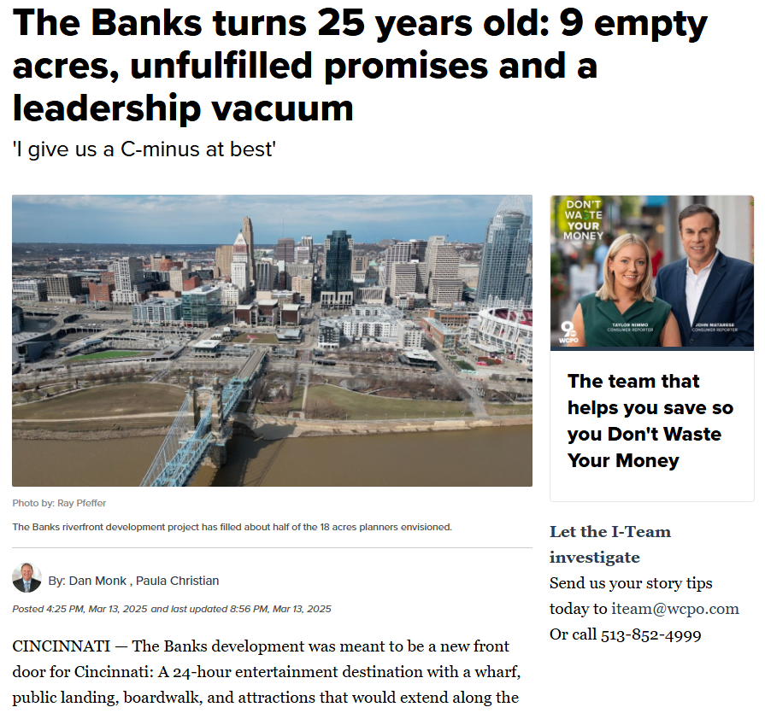
Banks shortcomings?

Slide 56
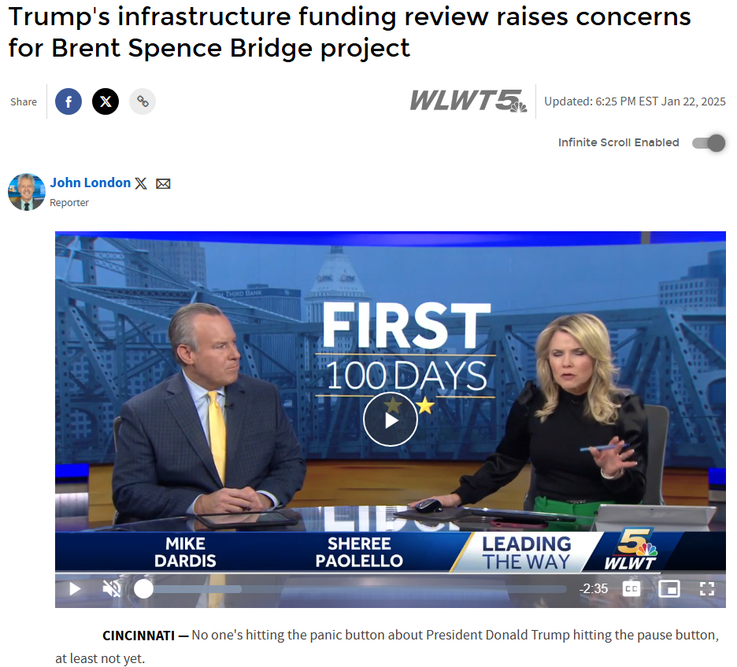
Brent Spence Problems?

Slide 57
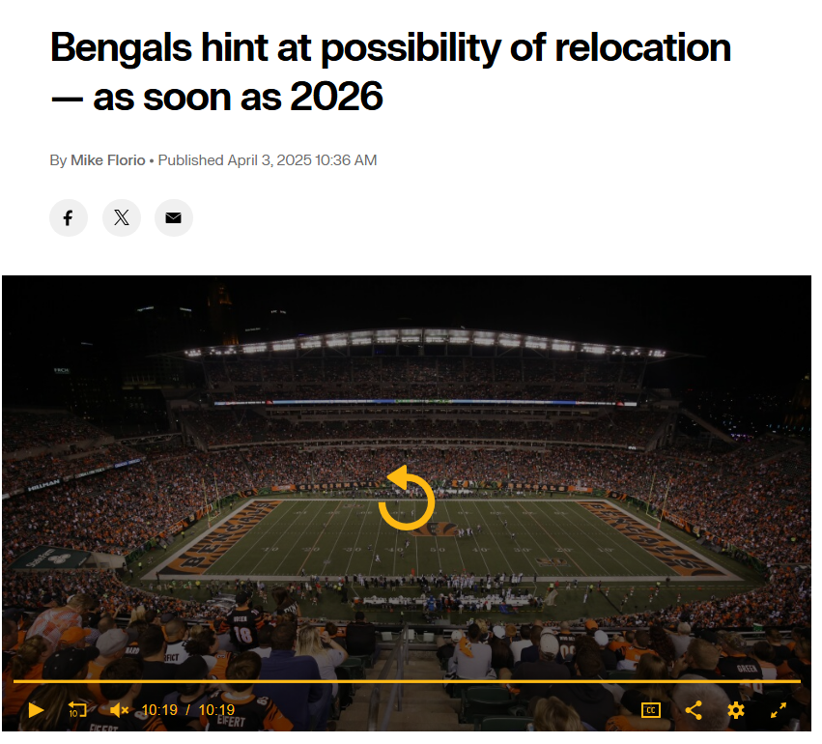
Bengals Moving?

Slide 58
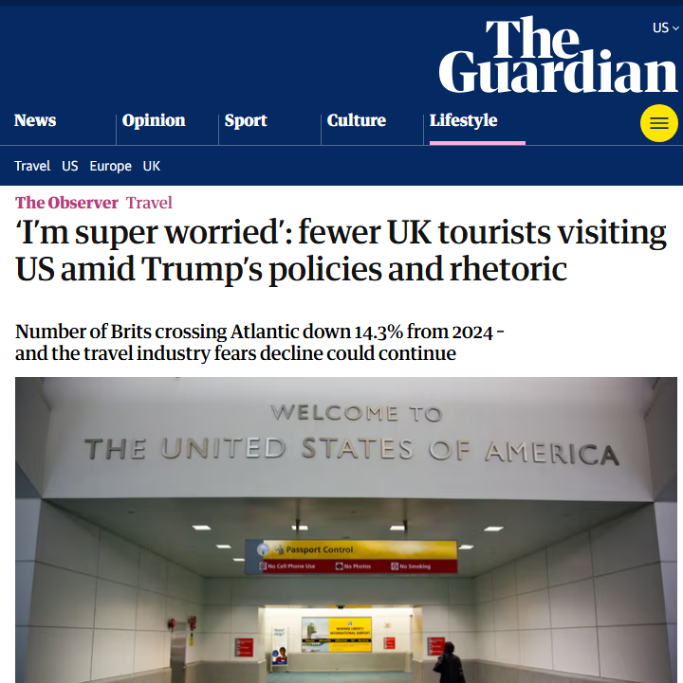
Tourism under threat?

Slide 59
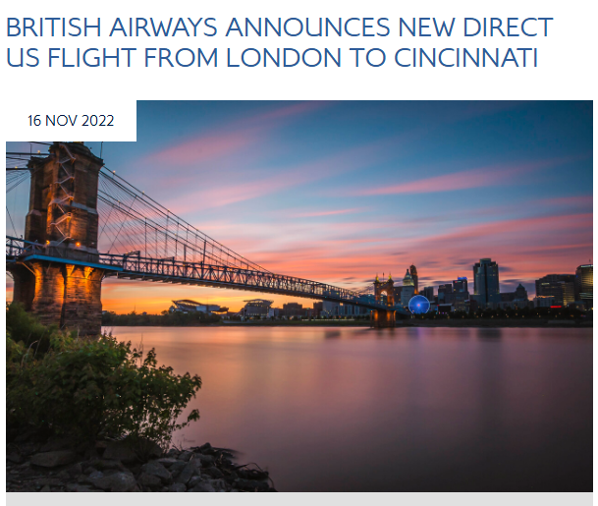
Tourism under threat?

Slide 60

Overaction?
Maybe the news just makes us overreact?
It appears the baseball and brews carry on.

Slide 61

Thanks!
You can find me at:
https://www.linkedin.com/in/charles-altendorf/
The annual Geography in Bluegrass Day celebration
Kentucky Association of Mapping Professionals Events

Slide 62
Credits
Special thanks to all the people who made and released these awesome resources for free:
Presentation template by SlidesCarnival
Photographs by Unsplash

Slide 63
Presentation design
This presentation uses the following typographies:
Titles: Red Hat Display
Body copy: Raleway
Download for free at:
https://www.fontsquirrel.com/fonts/red-hat
https://www.fontsquirrel.com/fonts/raleway
You don’t need to keep this slide in your presentation. It’s only here to serve you as a design guide if you need to create new slides or download the fonts to edit the presentation in PowerPoint®

Slide 64

Free templates for all your presentation needs
For PowerPoint and Google Slides
100% free for personal or commercial use
Ready to use, professional and customizable
Blow your audience away with attractive visuals

